Slide 1
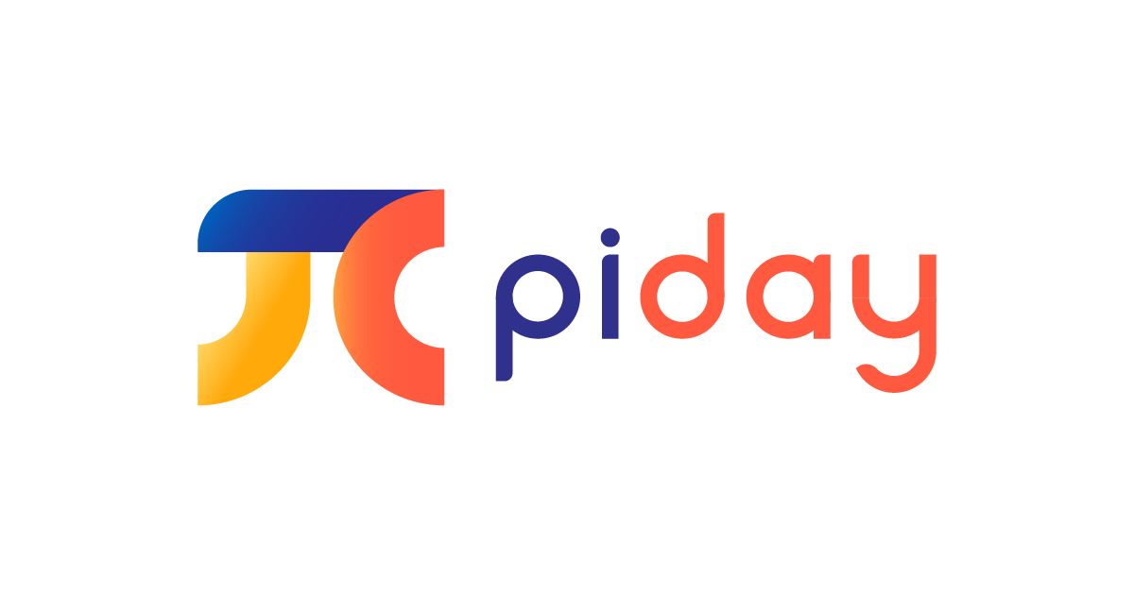
Let’s make a pi(e) with apptrader
By Wreck it ralph consulting

Slide 2
How did we pick the top ten?
Prioritized Net-Profit
Available on Apple Store and Google Play for Greater Monthly Revenue
A Focus on Longevity of Apps
Lower Initial investments for Faster Break-Even Point
Variety in Popularity
Related to Pi Day

Slide 3
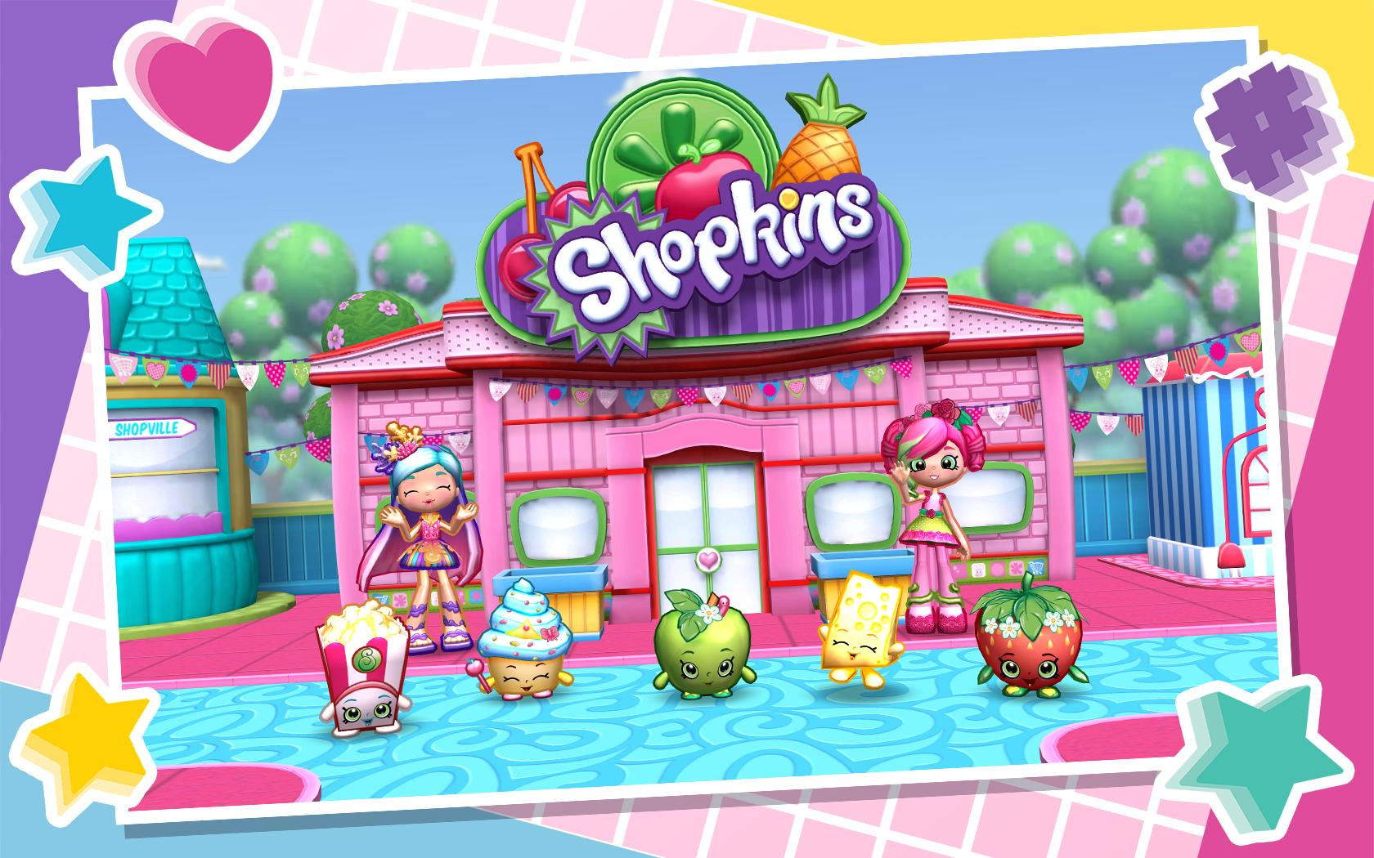
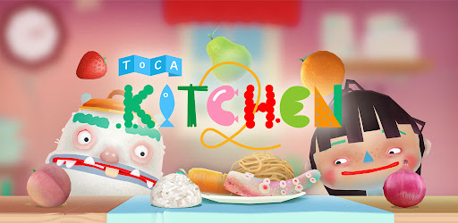
Let’s Go shopping
Shopkins World
Shop all you want with cute little characters who live in an enormous Shopkins World!
Toca’s Kitchen 2
An educational cooking app where anyone can be a Master Chef!
Nearly 345K reviews
Content Rating: Everyone/4+
Average Rating: 4.15 Stars
Initial Investment: $20K
Break-Even Point: 5 Months
Est. Lifespan: 9 Years
Net Profit Over App Lifespan: $412K
Over 3 Million Reviews
Content Rating: Everyone/4+
Average Rating: 4.5 Stars
Initial Investment: $40K
Break-Even Point: 10 Months
Est. Lifespan: 10 Years
Net Profit Over App Lifespan: $440K

Slide 4

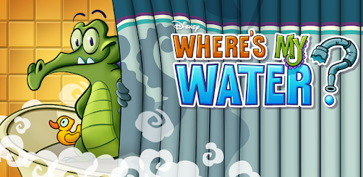
Let the baking begin
Cooking Fever
Wanna become the best chef in town and be an expert in different cuisines? Cooking fever is for you!
Where’s My Water?
A popular Disney App where players must clear barriers from a sewer system to provide clean water to Swampy the Alligator.
Over 6.6 Million Reviews
Content Rating: Everyone/4+
Average Rating: 4.5 Stars
Initial Investment: $20K
Break-Even Point: 5 Months
Est. Lifespan: 10 Years
Net Profit Over App Lifespan: $460K
Over 3 Million Reviews
Content Rating: Everyone/4+
Average Rating: 4.6 Stars
Initial Investment: $40K
Break-Even Point: 10 Months
Est. Lifespan: 10 Years
Net Profit Over App Lifespan: $440K

Slide 5
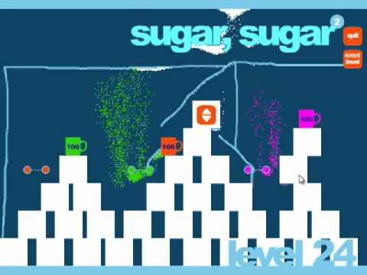
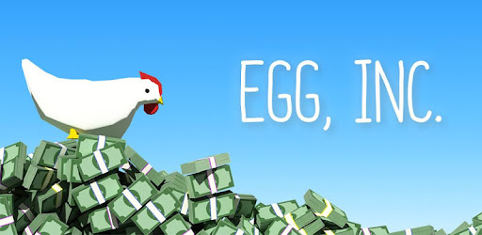
Start with the basics
Sugar, Sugar
Challenge your strategic skills by adding sugar, sugar to your cup of games.
Egg, Inc
Unlock the secret of the gold rush by building the most advanced egg farm in the world.
Over 1500 Reviews
Content Rating: Everyone/4+
Average Rating: 4.35 Stars
Initial Investment: $32K
Break-Even Point: 8 Months
Est. Lifespan: 10 Years
Net Profit Over App Lifespan: $448K
Over 650K Reviews
Content Rating: Everyone/4+
Average Rating: 4.85 Stars
Initial Investment: $20K
Break-Even Point: 5 Months
Est. Lifespan: 11 Years
Net Profit Over App Lifespan: $508K

Slide 6
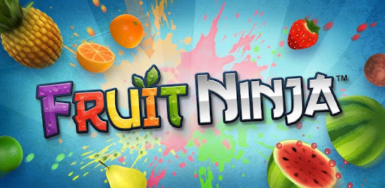
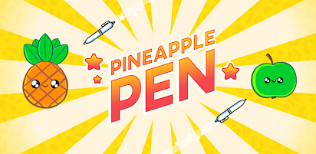
Now Add the fruit
Fruit Ninja Classic
Shop all you want with cute little characters who live in an enormous Shopkins World!
Pineapple Pen
A popular Disney App where players must clear barriers from a sewer system to provide clean water to Swampy the Alligator.
Over 780K Reviews
Content Rating: Everyone/4+
Average Rating: 4.4 Stars
Initial Investment: $20K
Break-Even Point: 10 Months
Est. Lifespan: 10 Years
Net Profit Over App Lifespan: $440K
Over 160K Reviews
Content Rating: Everyone/4+
Average Rating: 4.4 Stars
Initial Investment: $20K
Break-Even Point: 5 Months
Est. Lifespan: 10 Years
Net Profit Over App Lifespan: $460K

Slide 7

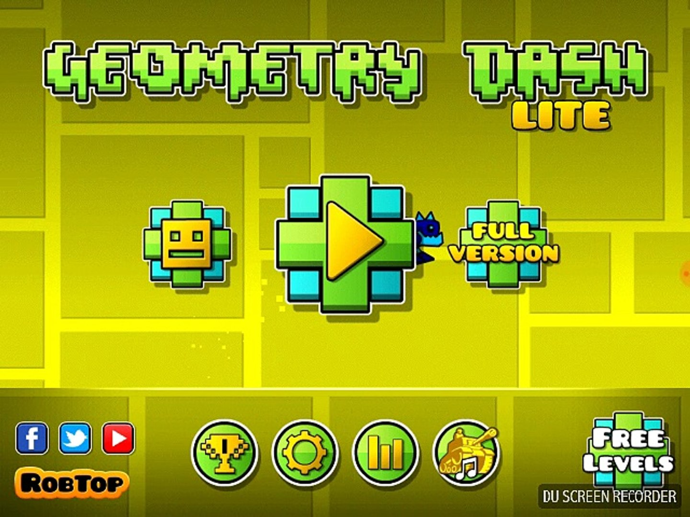
Add a dash of math…
PewDiePie’s Tuber Simulator
Follow the footsteps of an internet sensation and build your “Tuber” fame with creative videos!
Geometry Dash Lite
Jump, fly, and dash your way through dangerous geometrical obstacles!
Over 1.5 million reviews
Content Rating: Teen/9+
Average Rating: 4.9 Stars
Initial Investment: $20K
Break-Even Point: 5 Months
Est. Lifespan: 11 Years
Net Profit Over App Lifespan: $508K
Over 6.5 Million Reviews
Content Rating: Everyone/4+
Average Rating: 4.75 Stars
Initial Investment: $20K
Break-Even Point: 5 Months
Est. Lifespan: 11 Years
Net Profit Over App Lifespan: $508K

Slide 9
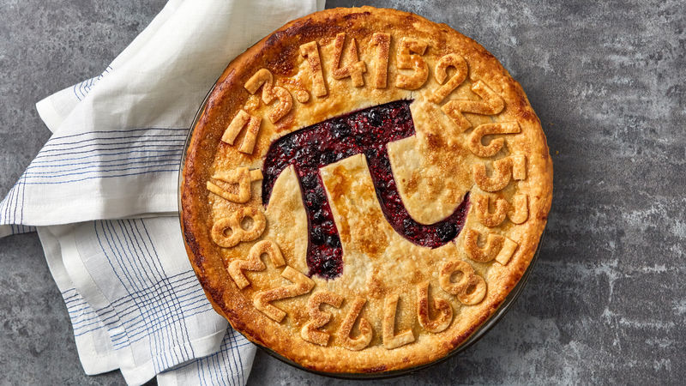
ANY QUESTIONS?

